Slide 1

Exercise 1 - Finite State Machine in Python: NPC brain’s behaviour
Saccotelli Leonardo - 761047

Slide 2

Goal
Implement the NPC behaviour of a sci-fi game set in a cyberpunk world using a Finite State Machine (FSM).
The NPCs are advanced AI-controlled robotic guards.
NPC are the backbone of the corporations' security systems, patrolling, detecting anomalies, and responding dynamically to the player’s actions.

Slide 3

How?
NPC behaviour is formalized adopting the JSON format to capture the key components of the FSM.
FSM coded in Python, implementing both the batch and interactive mode.
Library used:
click 8.1.8
colorama 0.4.6
graphviz 0.20.3

Slide 4
NPC behavior: States
Patrol: NPC moves along predefined routes, scanning for unusual activity.
Investigate: NPC moves to the last known location of a suspicious entity to gather more information.
Attack: NPC engages the player, using weapons and tactics to neutralize the threat.
Retreat: NPC withdraws from combat to regroup or repair.
Reboot: NPC performs system diagnostics and self-repair routines after retreating or being damaged.
Idle: NPC remains inactive, either due to a failed reboot or lack of immediate threats.
Call Backup: NPC sends a distress signal for reinforcements and temporarily retreats.
Search Area: NPC expands its search radius, scanning the environment for the player.
Monitor: NPC passively observes the player when seems non-hostile.
Initial state: Patrol - Accept states: Patrol, Idle

Slide 5
NPC behavior: Events
Player detected: NPC directly sees or senses the player in its detection radius.
Player suspicious: NPC observes unusual or ambiguous player behavior.
Player hostile: NPC identifies the player as a direct threat, such as attacking, hacking systems, or destroying objects.
Player not hostile: NPC determines that the player's actions are non-threatening after investigation
Player out of sight: NPC loses visual or sensory contact with the player, such as when the player hides or escapes the detection radius.
Low health: NPC's health drops below a critical threshold, prompting defensive or retreating behavior.
System damaged: NPC sustains significant damage, requiring it to enter a reboot or idle state for repairs.
Player defeated: NPC successfully neutralizes the player.
System repaired: NPC completes its self-repair routines or receives external repairs, allowing it to resume normal activities.
Backup arrived: Reinforcements summoned by the NPC arrive on the scene, enabling it to re-engage or continue an attack.
Lost player: NPC concludes that it can no longer locate the player after a prolonged search.
Player attacking others: NPC observes the player engaging in combat with other NPCs or damaging allied systems, triggering an escalation.

Slide 6
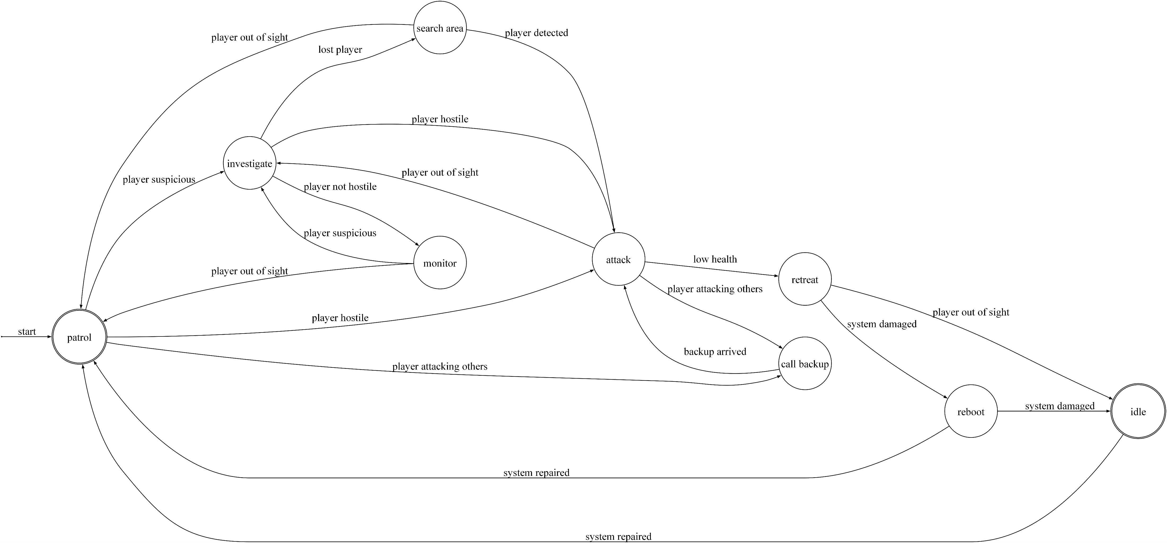
NPC behavior: Rapresentations

Slide 7
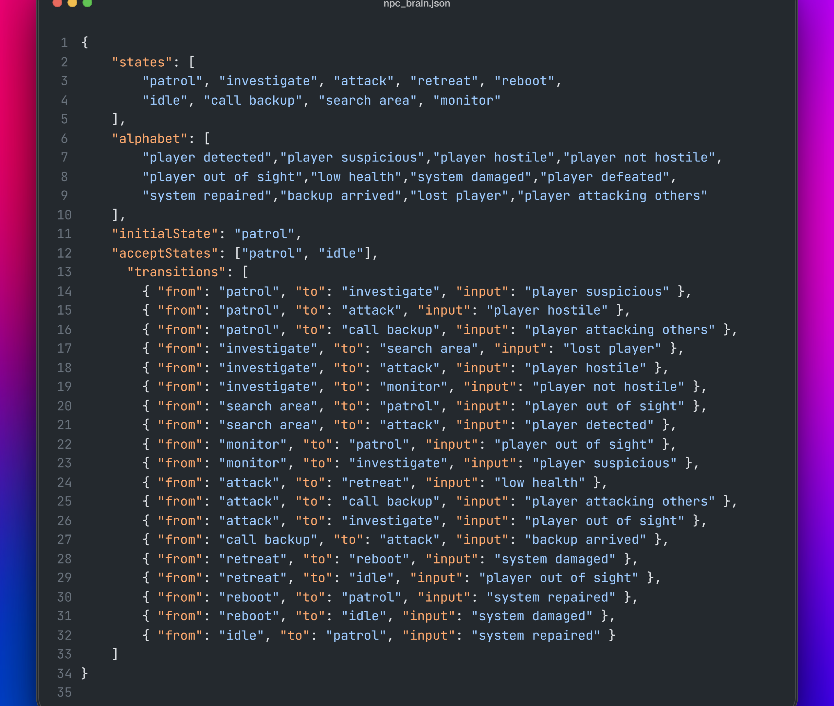
JSON File

Slide 8

Python implementation
fsm.py → a class that model the FSM behavior with the following methods:
get_valid_input()
transition()
run()
print_acceptance()
print_model()
draw_model()
main.py → the program to simulate the behavior of the NPC, both in batch and iterative mode.

Slide 9
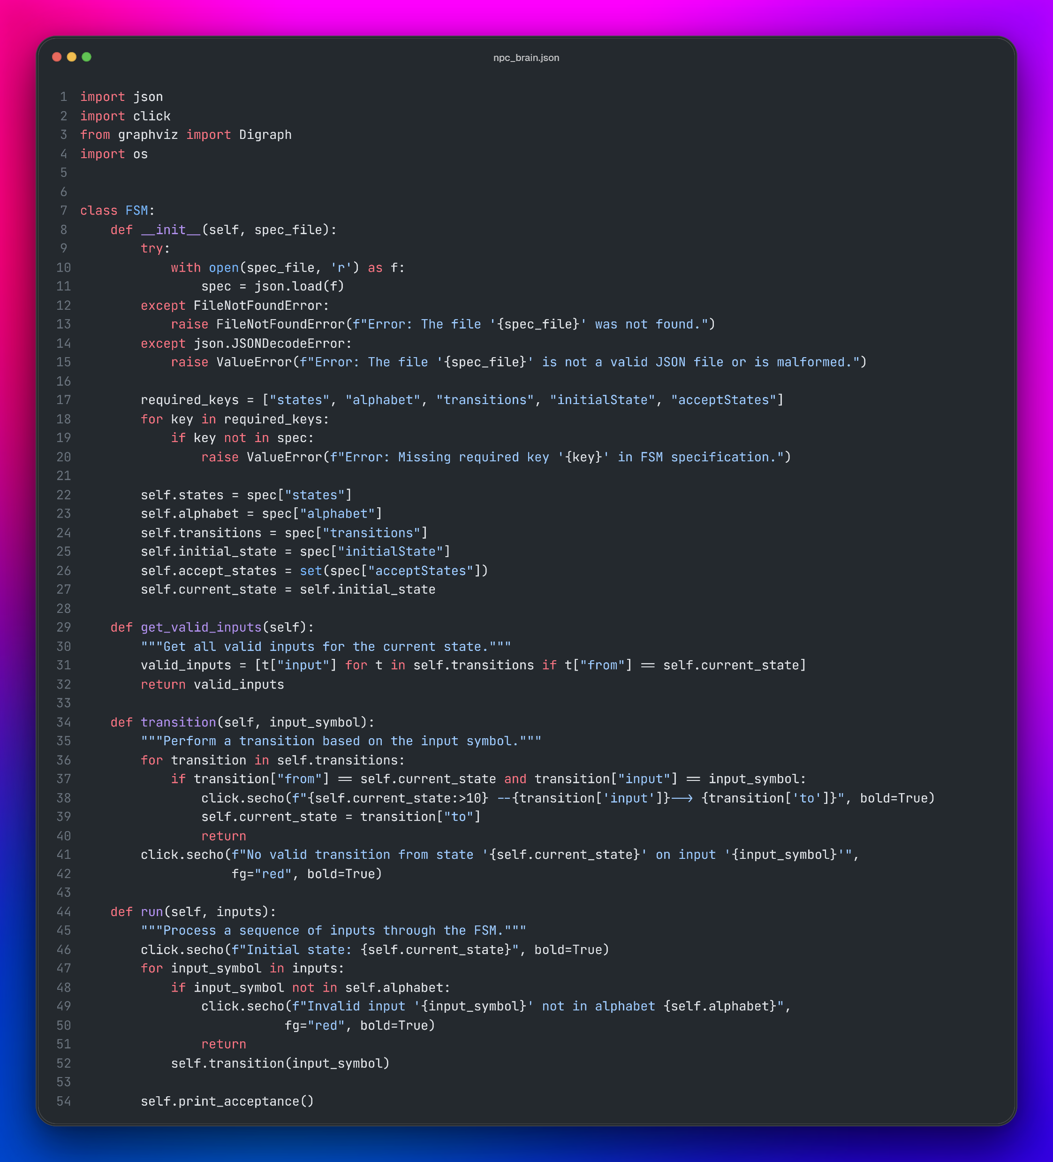
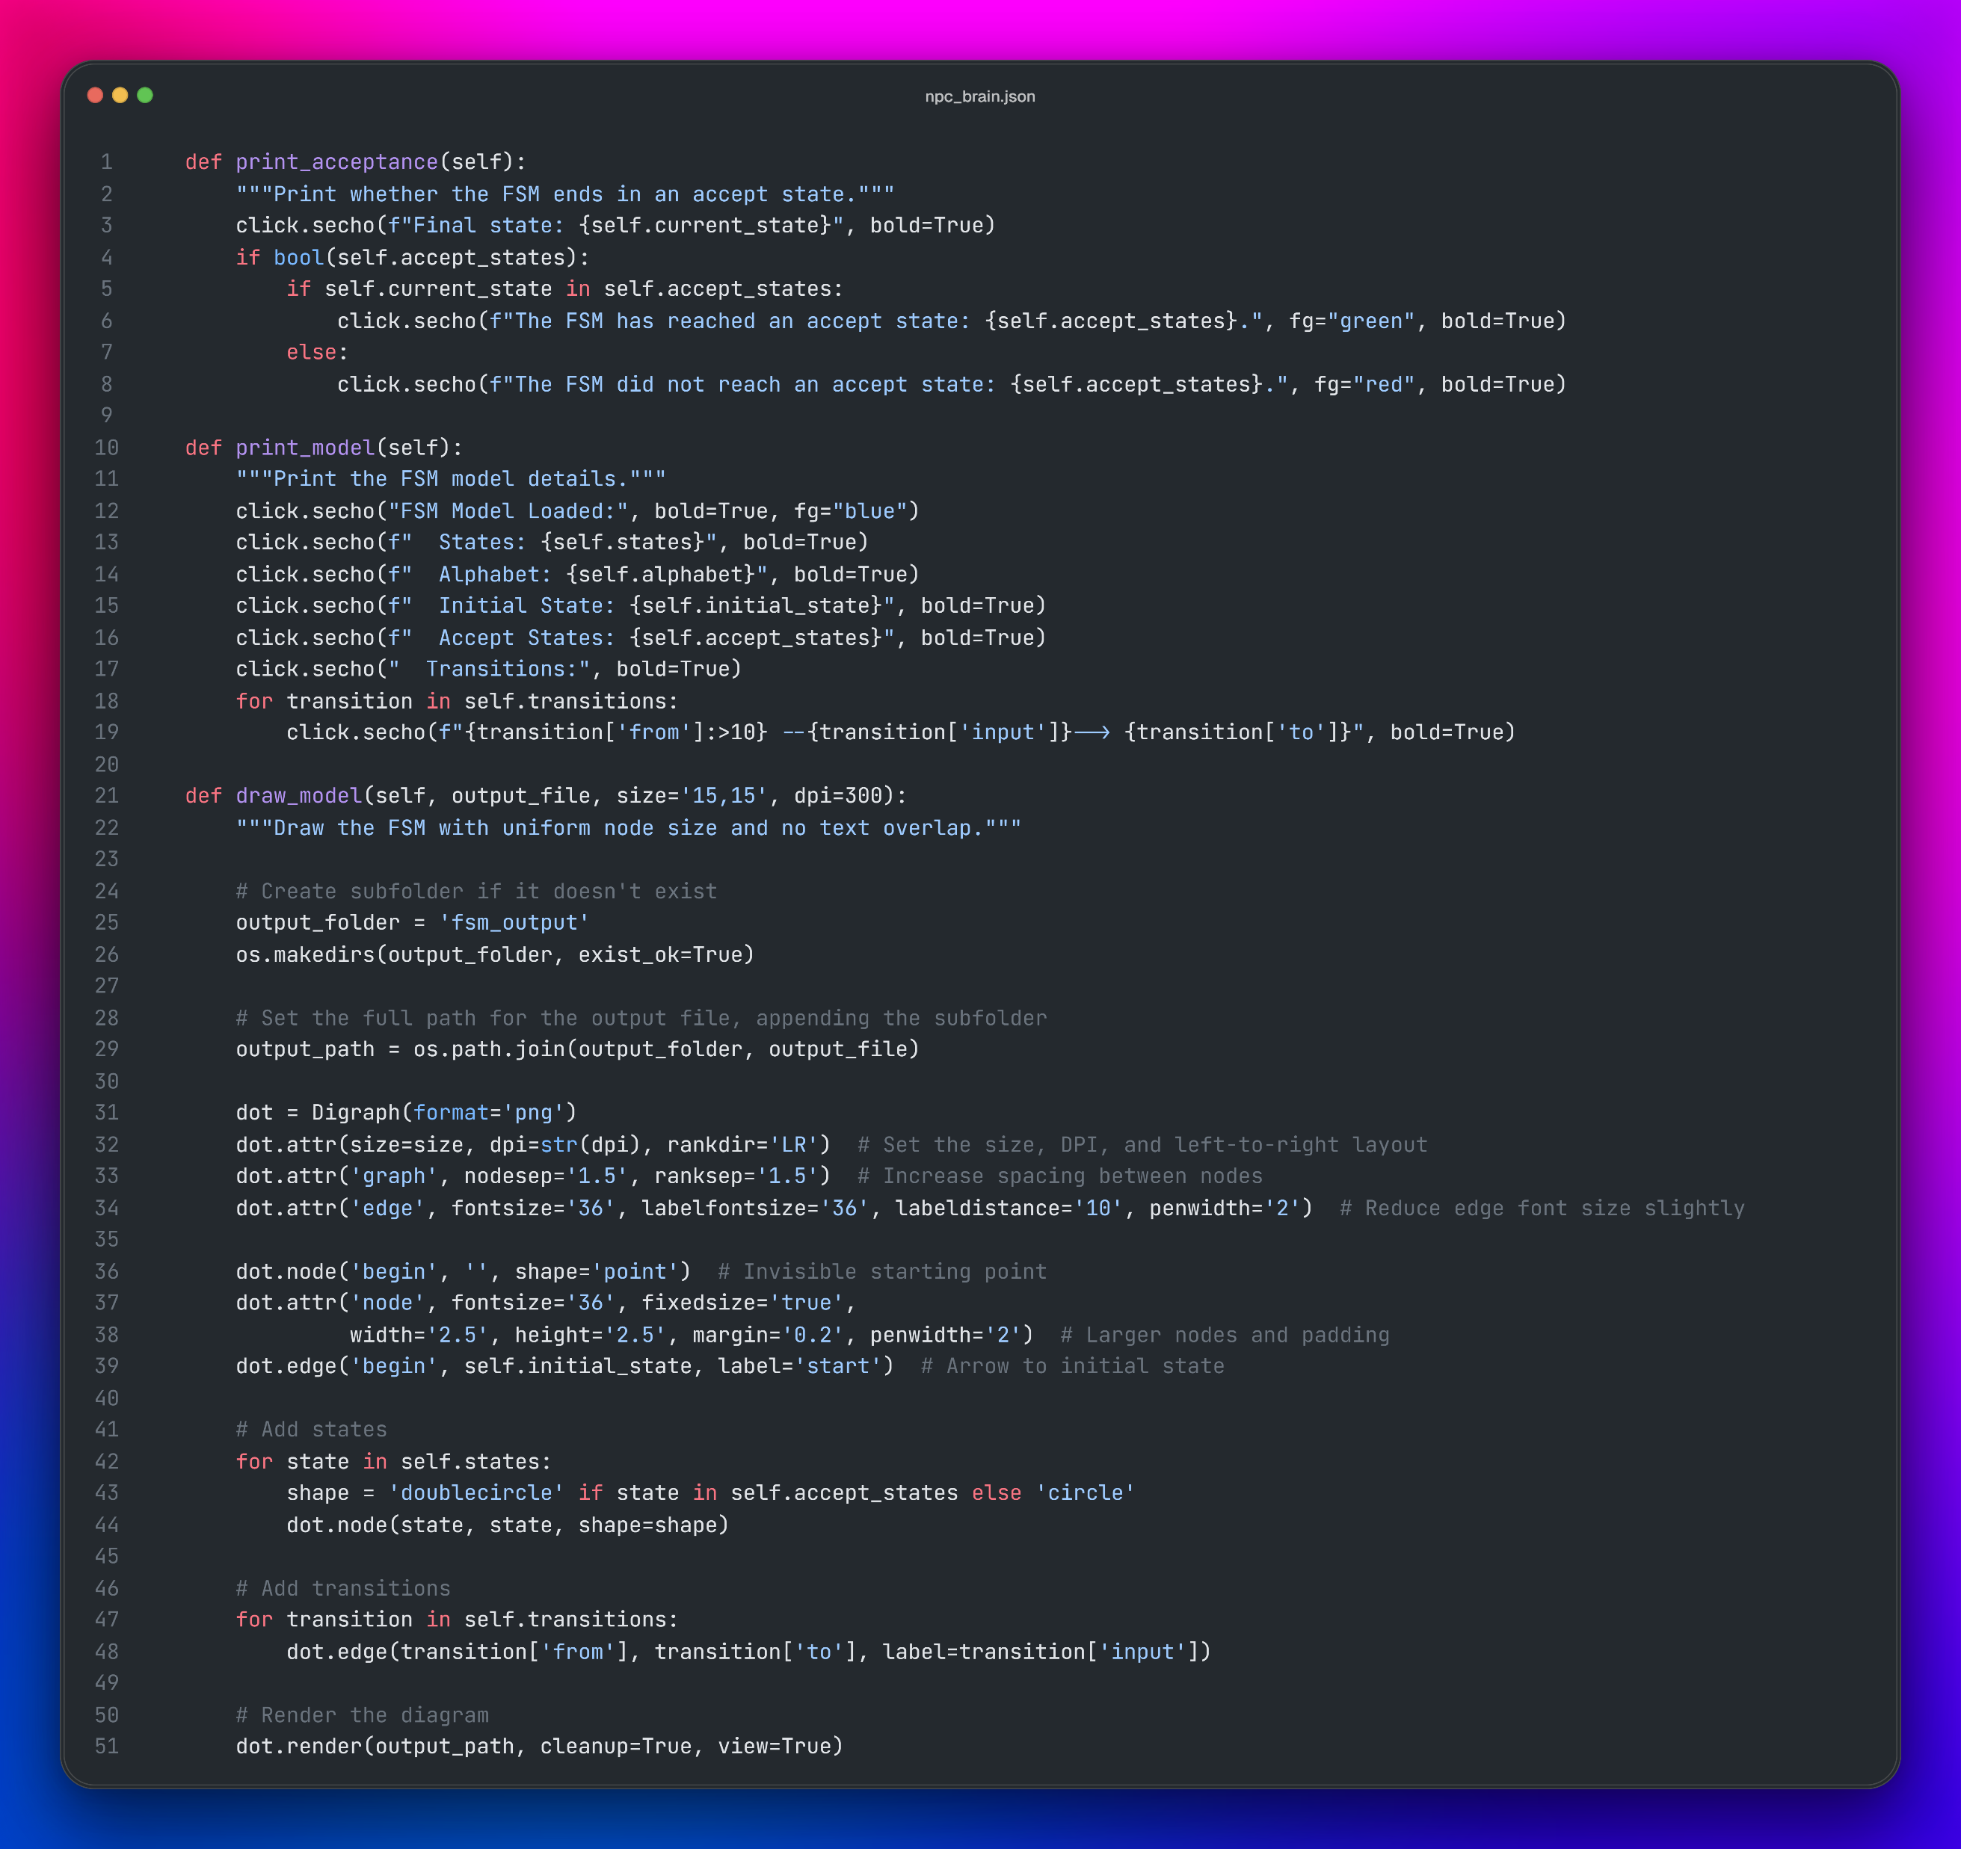

Slide 10
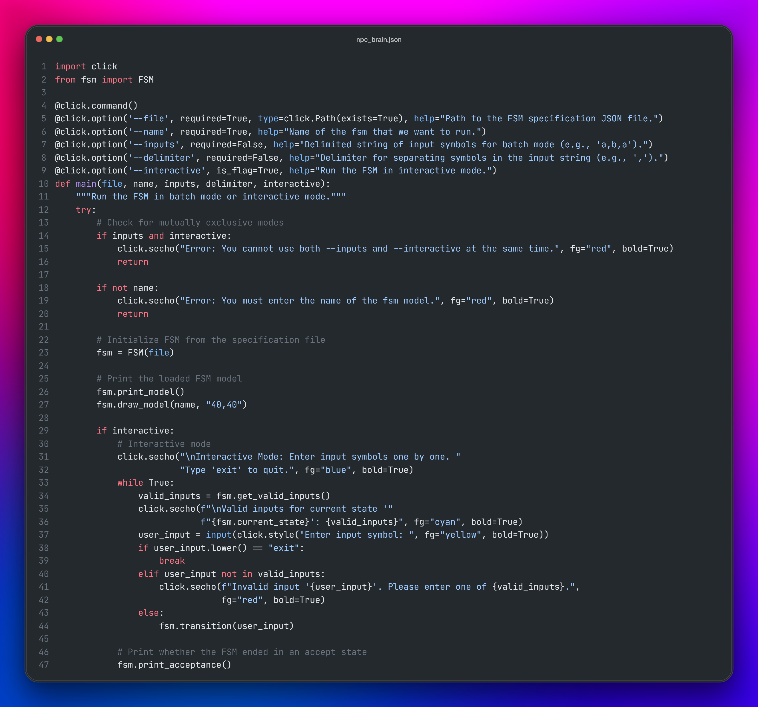
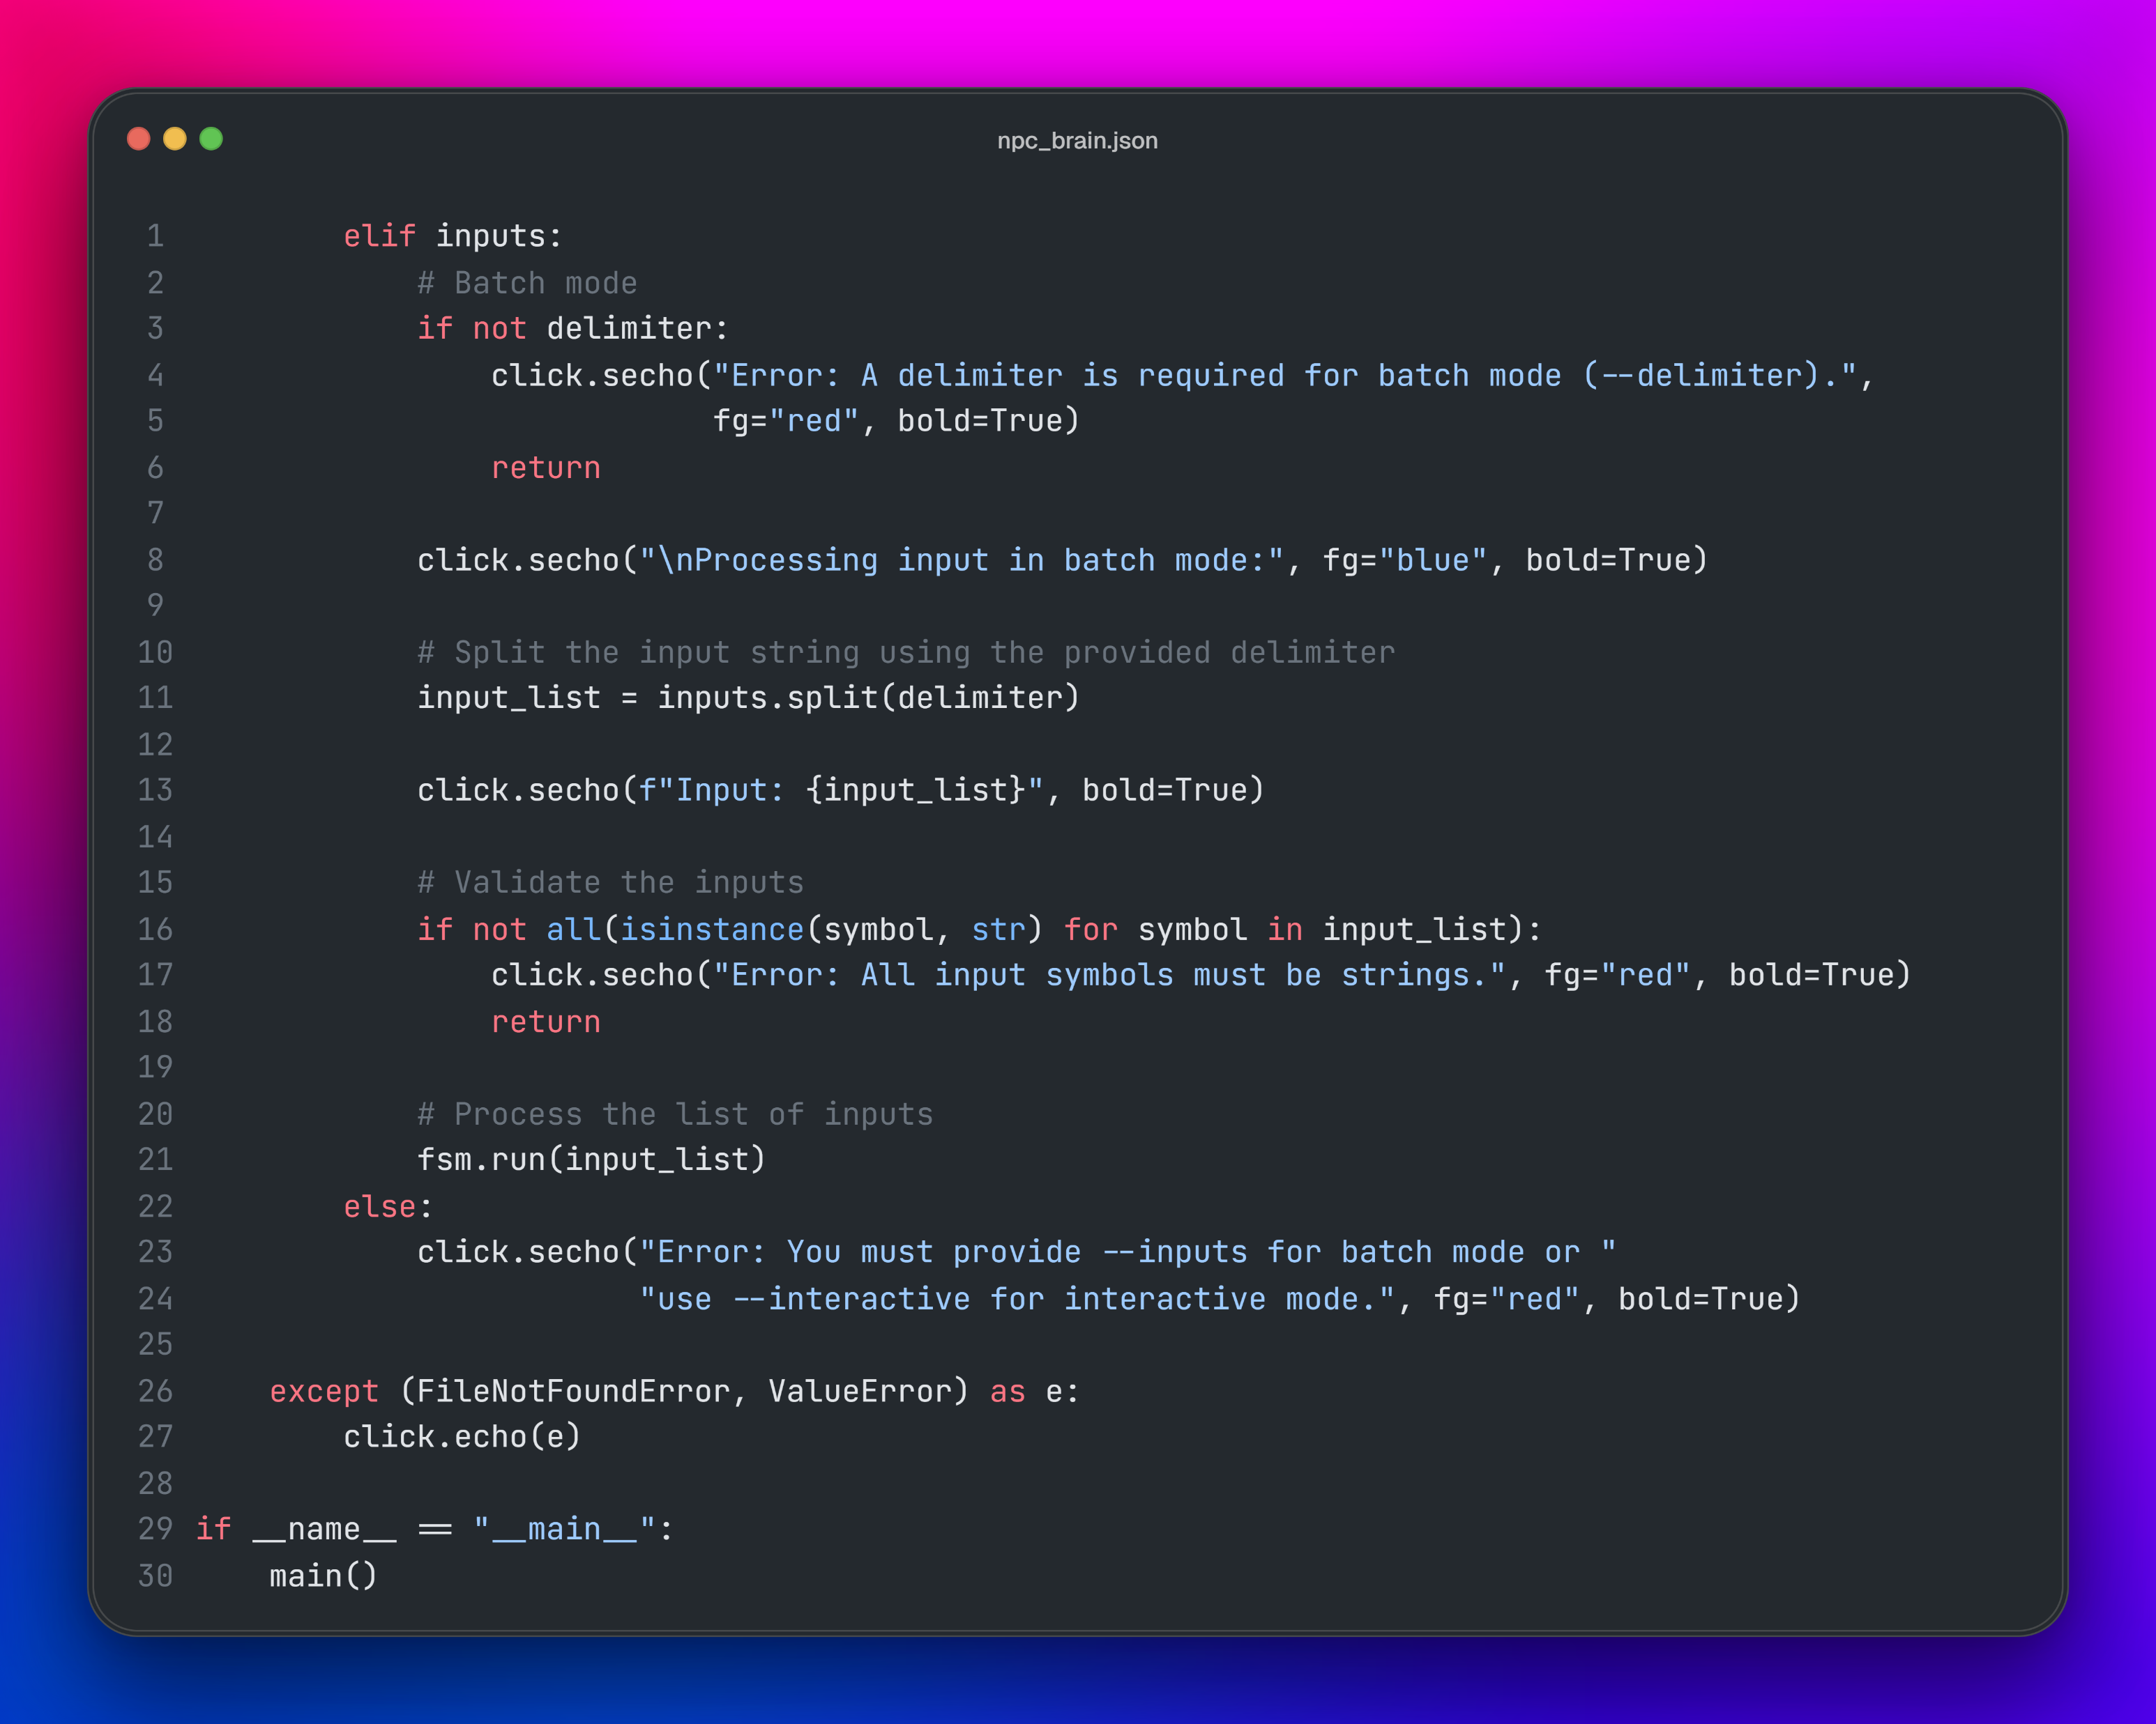

Slide 11
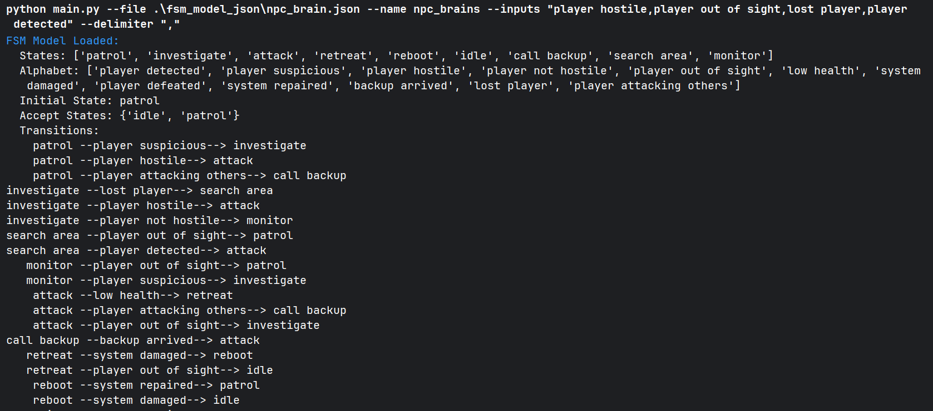
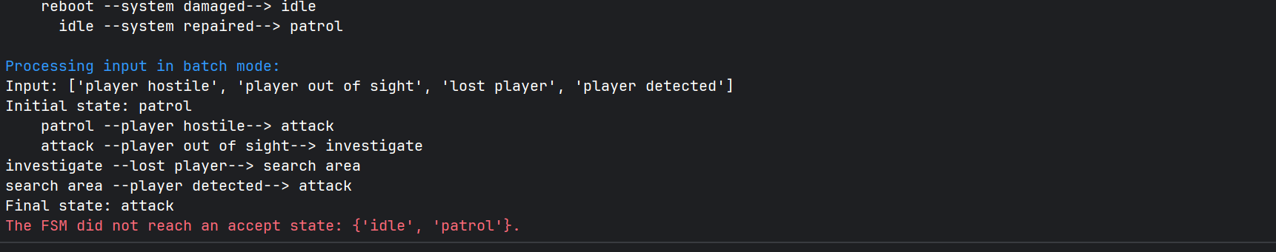
NPC behavior: Batch Test

Slide 12
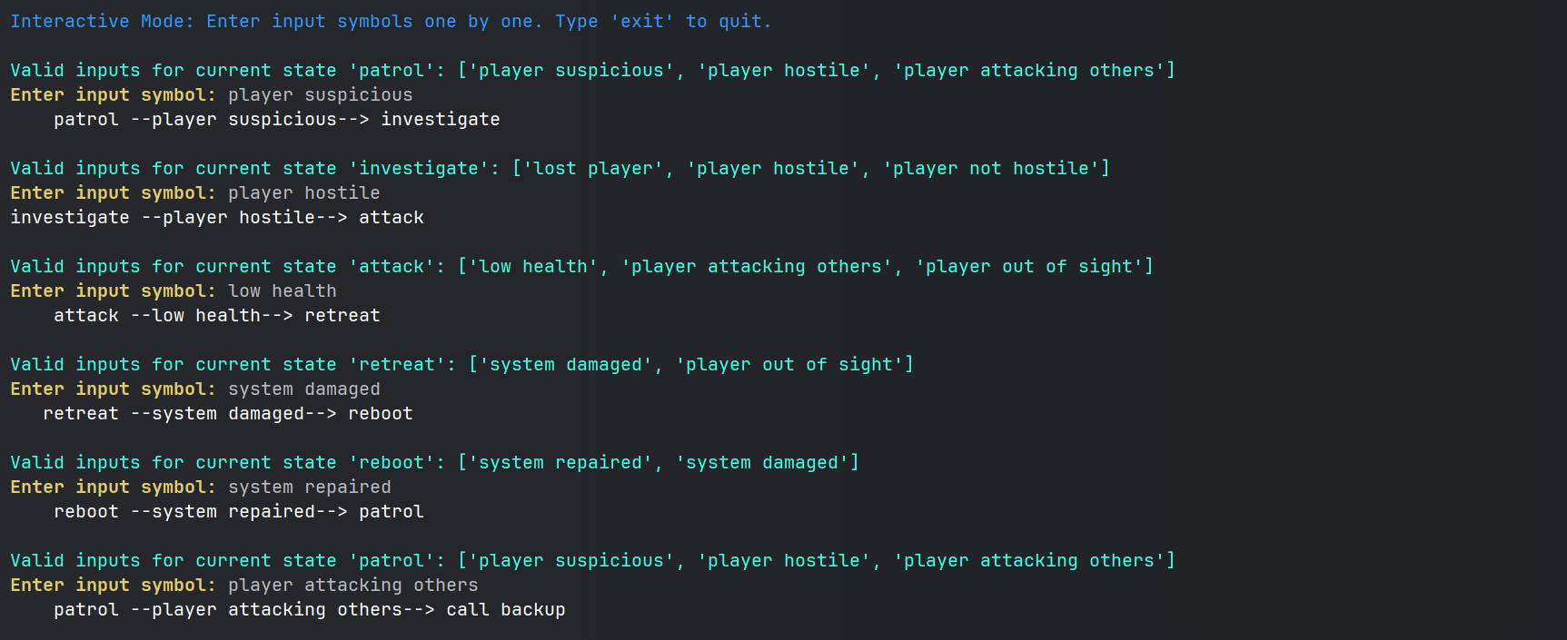
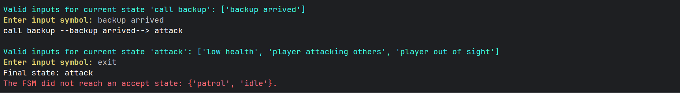
NPC behavior: Interactive Test

Slide 13
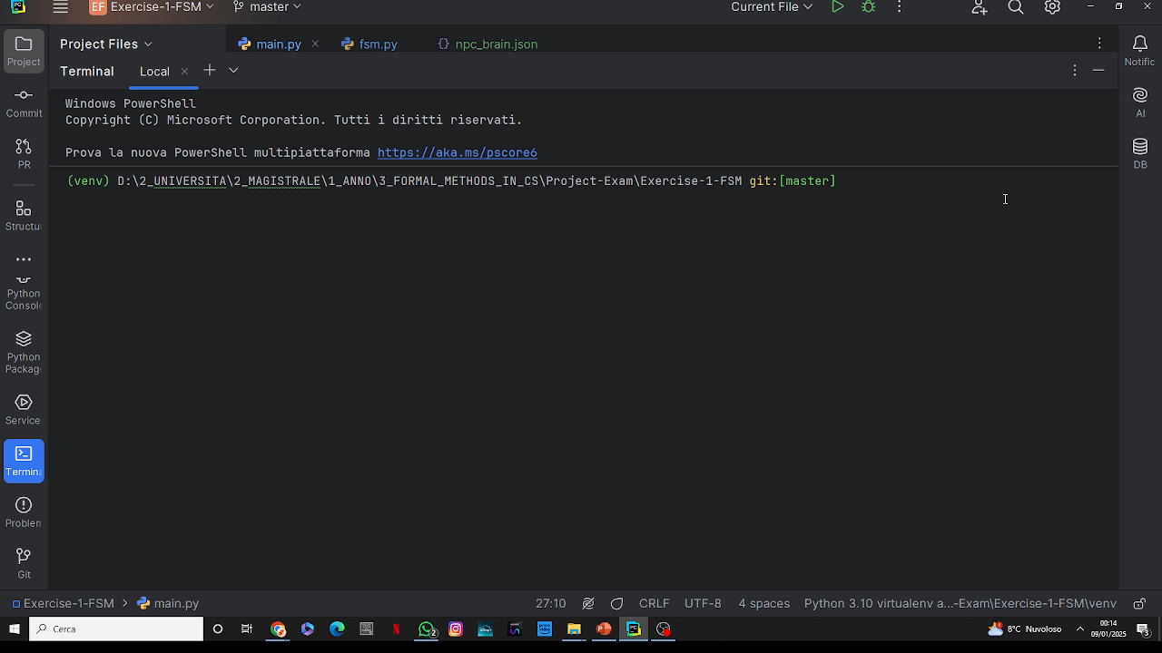
NPC behavior: Interactive Test

Slide 14

Thank for the attention Formal methods for computer science Prof. Berardina De Carolis Università degli studi di Bari Aldo Moro Computer Science
Leonardo Saccotelli
l.saccotelli@studenti.uniba.it

